Slide 1
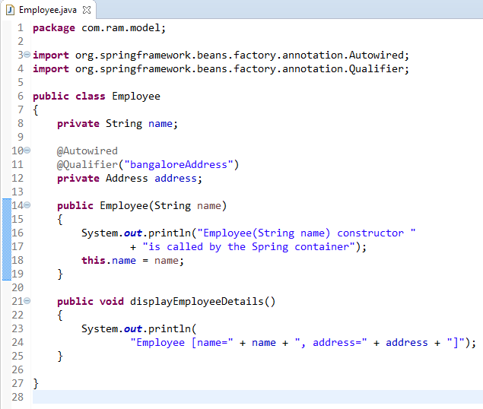
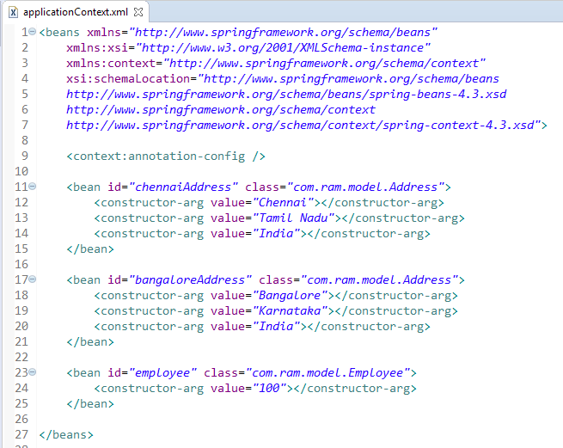
@Qualifier Annotation
The @Qualifier annotation us used to control which bean should be autowire on a field.

Slide 2
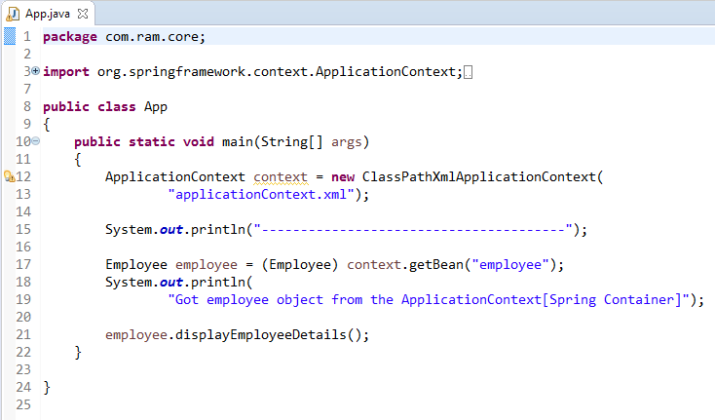
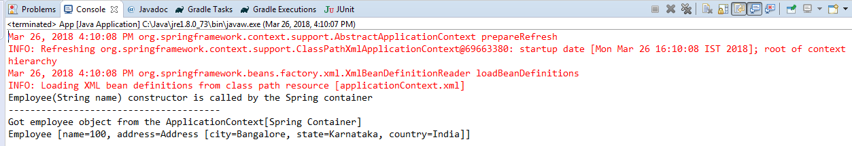
@Qualifier Annotation

